Slide 1
Configuration Guide
(WAS – Jeus 6.0.0.5)
2009. 08. 16
CODELABOR
Shin Sang Jae (codelabor@gmail.com)

Slide 2
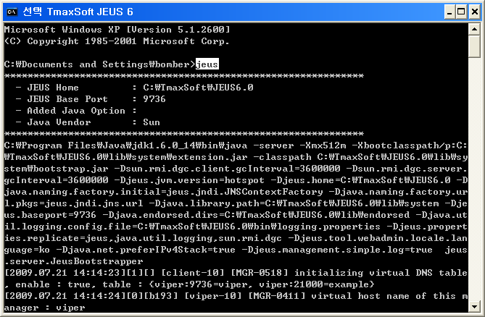
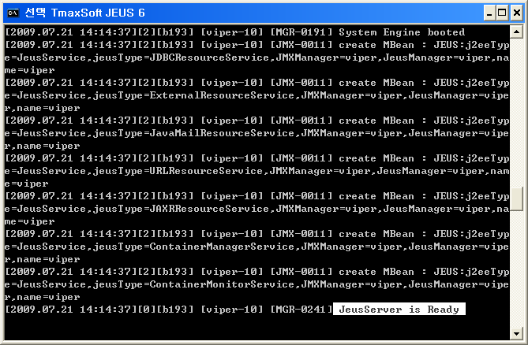
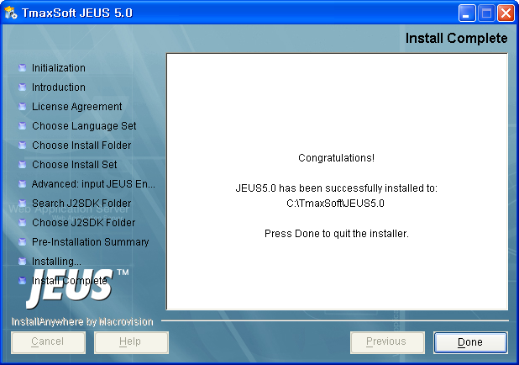
Jeus
Run Jeus Server
Run Jeus Server
Command: jeus

Slide 3
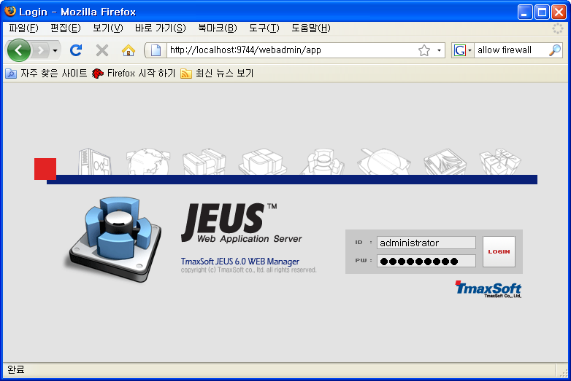
Jeus
Web Admin
Run Jeus WebAdmin
URL: http://localhost:9744/webadmin
ID: administrator
PW: jeusadmin

Slide 4
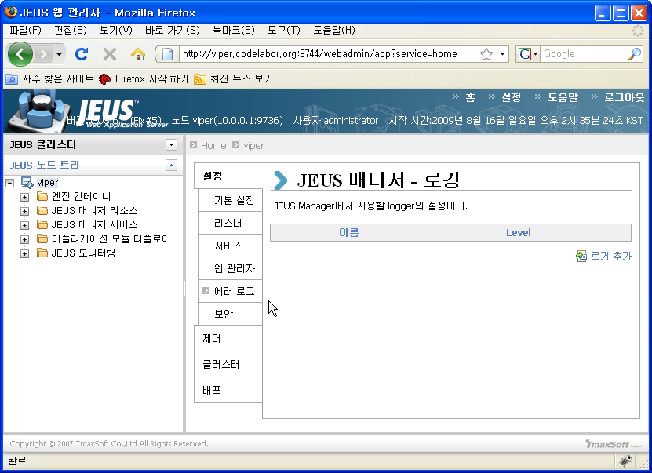
Jeus
Logger - Node
Left Pan: Node Name
Right Pan: 에러 로그
  Click 로거 추가

Slide 5
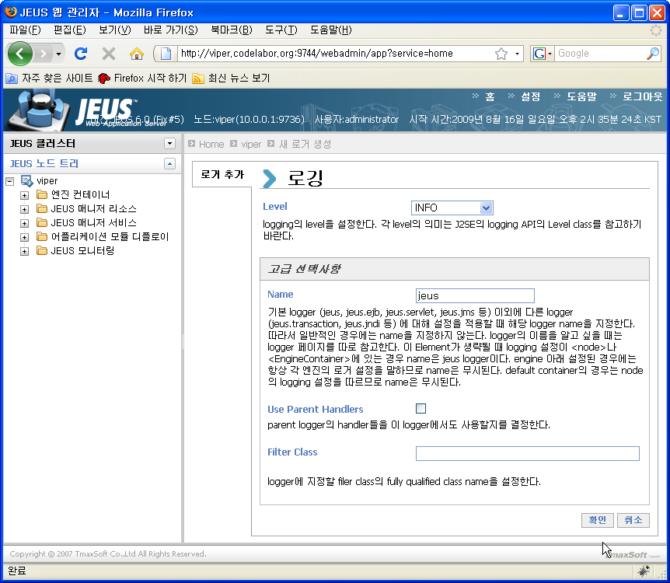
Jeus
Logger - Node
Default Settings
Click 확인 Button

Slide 6
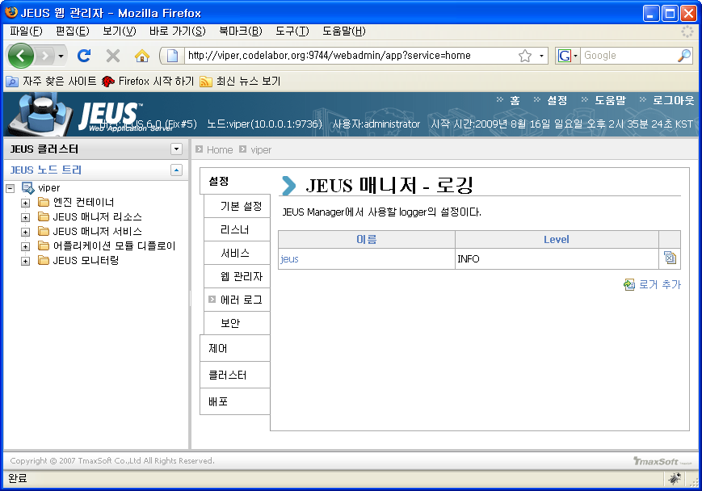
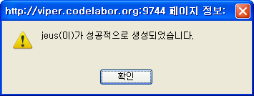
Jeus
Logger - Node
Success Dialog
  Confirm
Right Pan: 설정 Tab
  Click 로거 추가

Slide 7
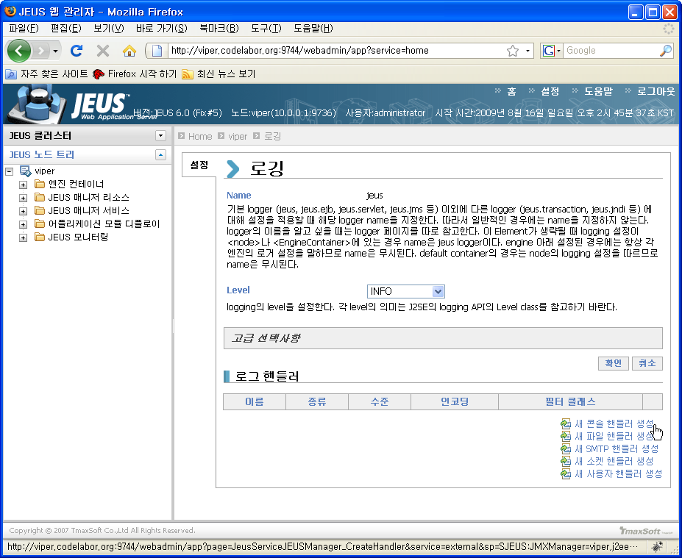
Jeus
Logger - Node
Select 새 콘솔 핸들러 생성

Slide 8
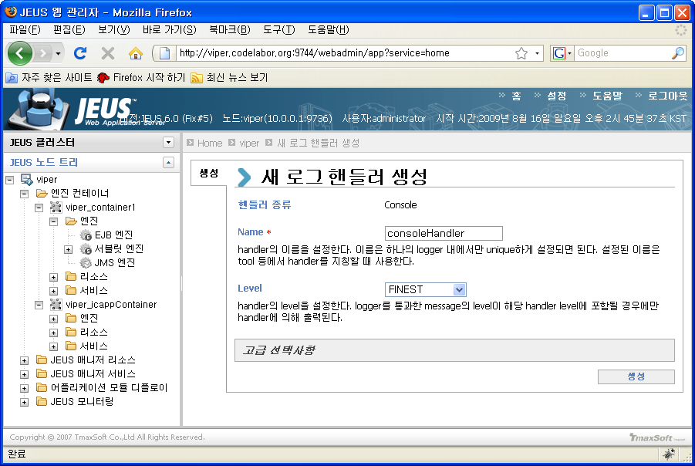
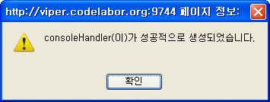
Jeus
Logger - Node
Name: consoleHandler

Slide 9
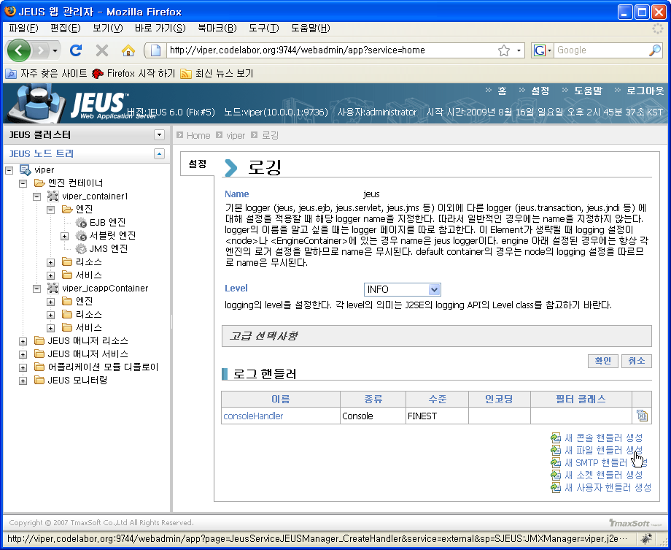
Jeus
Logger - Node
Select 새 파일 핸들러 생성

Slide 10
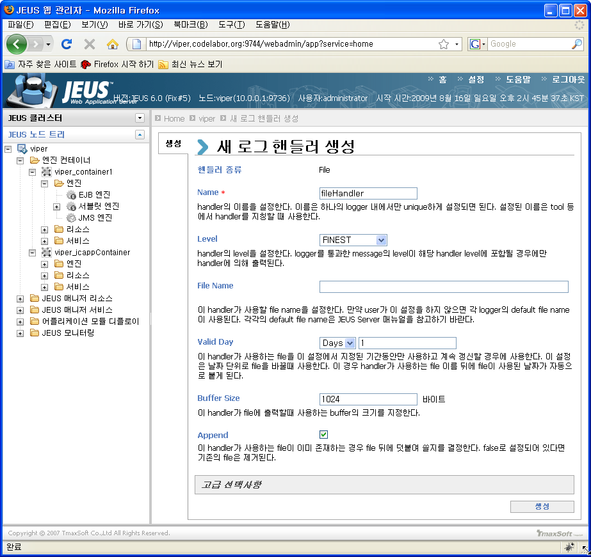
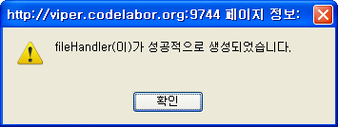
Jeus
Logger - Node
Name: fileHandler
Valid Day: Days / 1

Slide 11
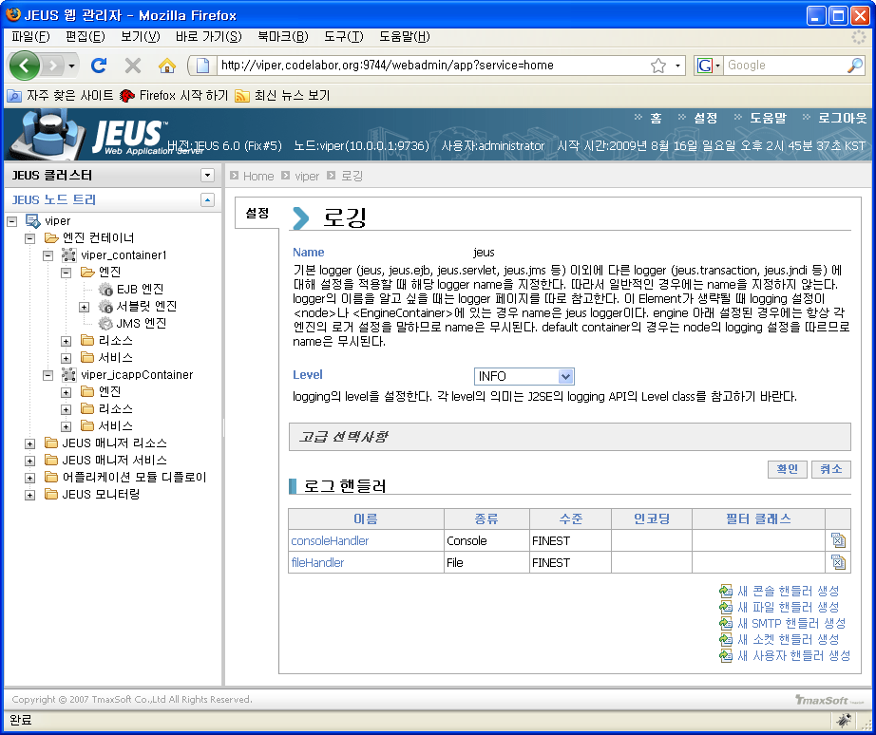
Jeus
Logger - Node
Check Web Admin

Slide 12
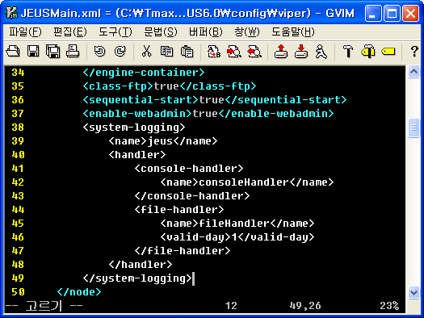
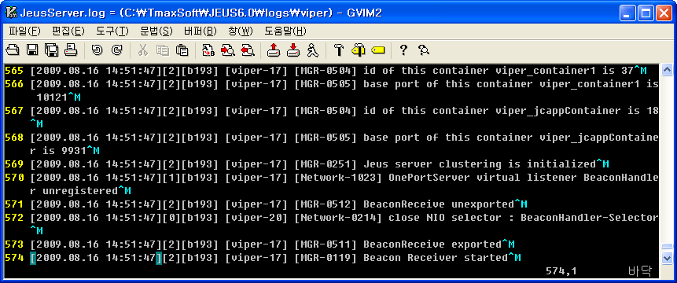
Jeus
Logger - Node
Check Configuration File
  File: C:\TmaxSoft\JEUS6.0\config\nodename\JEUSMain.xml
Check Log File
  File: C:\TmaxSoft\JEUS6.0\logs\nodename\JeusServer.log

